Slide 1
Triannual Report Data Tutorial

Slide 2
EHE Initiative Triannual Report Submission Timeline
Key dates for the Ending the HIV Epidemic (EHE) Initiative Triannual Report submission timeline.
Resource:
https://targethiv.org/library/ehe-initiative-triannual-report-submission-timeline

Slide 3
Using the Client Services Count Report (CSCR) to Complete the Triannual Report

Slide 4
EHE Initiative Services
The following services may appear on your Client Services Count report. These should be accumulated under 1a Ending the HIV Epidemic Initiative Services of the Triannual Report
Linkage – EHE EBI
Linkage to Care – IPS
Medication Adherence - EHE EBI
People In Care Not Suppressed – IPS
Re-engagement - EHE EBI
Retention - EHE EBI
Retention in Care – IPS
Initiative
AMC - EHE

Slide 5
Step 1: Login to e2Fulton, Click on Reports, Select Client Services Count Report (CSCR)

Slide 6
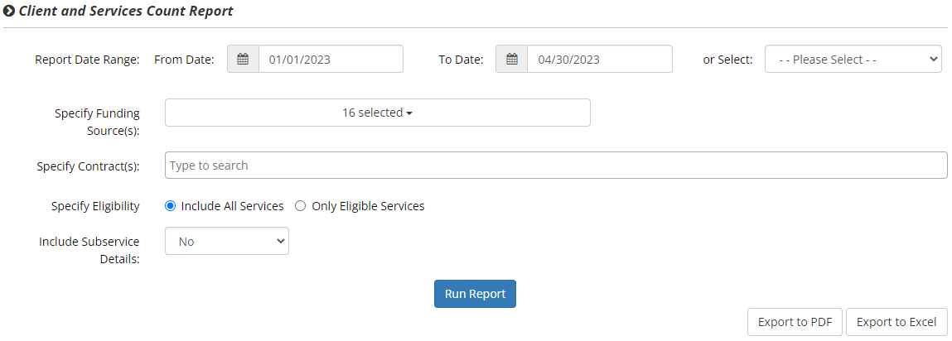
Step 2: Select date range 01/01/23 – 04/30/23
Step 3: Select all for funding sources
Step 4: Select no for include subservice details then select Run Report

Slide 7
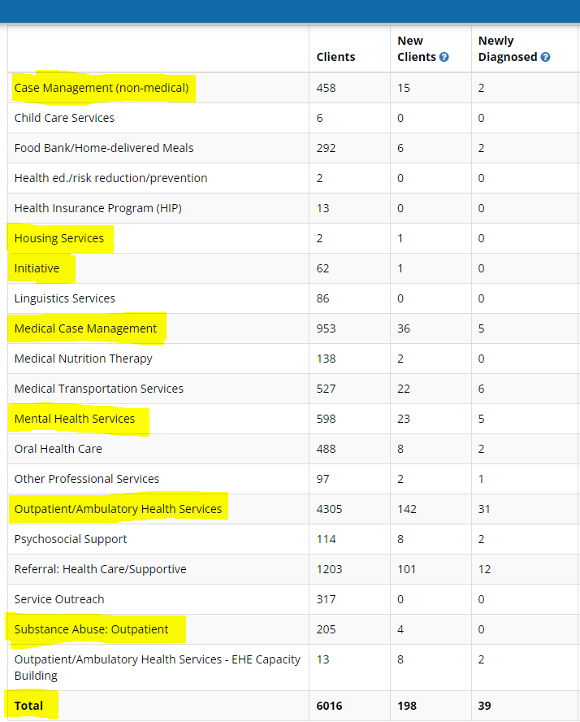
Step 5: You will receive a report similar to table below. Only categories you are funded for will appear on your report. The triannual report only asks about the categories that are highlighted. You will also include data about Prescribed ART; those instructions are in the second half of this tutorial.

Slide 8
Triannual Report= e2Fulton Client Services Count Report (CSCR)
Column A of triannual= New clients column CSCR
Column B of triannual= Clients- New Clients (CSCR) or Column A- Column C (triannual)
Column C of triannual= Clients column of CSCR
Data for column C
Data for column A
Client Services Count Report (CSCR)
Triannual Report
 | Services | # of New Clients who received service(s) in the reporting period¹ (A) | # of Clients who received service(s) in the reporting period and received at least one service during a previous reporting period of the current calendar year or during the previous calendar year² (B) | Total # of Clients who received service(s) in the reporting period (C)
 | RWHAP/ Initiative Services
 | 1. Any RWHAP³ or Initiative Service | 198 | 5818 | 6016
 | 1a. Ending the HIV Epidemic Initiative Services⁴ | 1 | 61 | 62
 | 1b. Outpatient/Ambulatory Health Services | 142 | 4163 | 4305
 | 1c. Medical Case Management, including Treatment Adherence Services | 36 | 917 | 953
 | 1d. Non-Medical Case Management Services | 15 | 443 | 458
 | 1e. Mental Health Services | 23 | 575 | 598
 | 1f. Substance Abuse Outpatient Care | 4 | 201 | 205
 | 1g. Substance Abuse Services (residential) | 0 | 0 | 0
 | 1h. Housing | 1 | 1 | 2
 | Health Outcomes
 | 2. Prescribed ART in the reporting period | 0 | 0 | 0
Data for row 1

Slide 9
Using the E2 Visual Analytics Report to retrieve Prescribed ART for the Triannual Report
Step 1: Select Reports
Step 2: Select e2 Visual Analytics

Slide 10
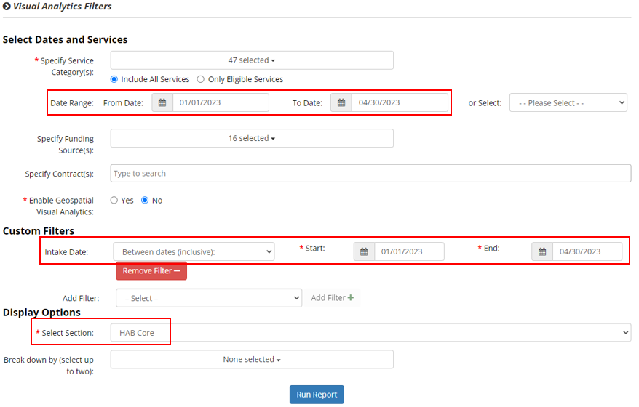
Step 3: Select Date Range 1/01/2023 – 04/30/2023
Step 4: Under Custom Filters, select Intake Date, click Add Filter, within Intake Date click down arrow to select Between dates (inclusive) and for *Start and *End dates enter 1/01/2023 – 04/30/2023
Step 5: Under Display Options, *Select Section: click down arrow to select HAB Core then click on Run Report, scroll down for your results.

Slide 11
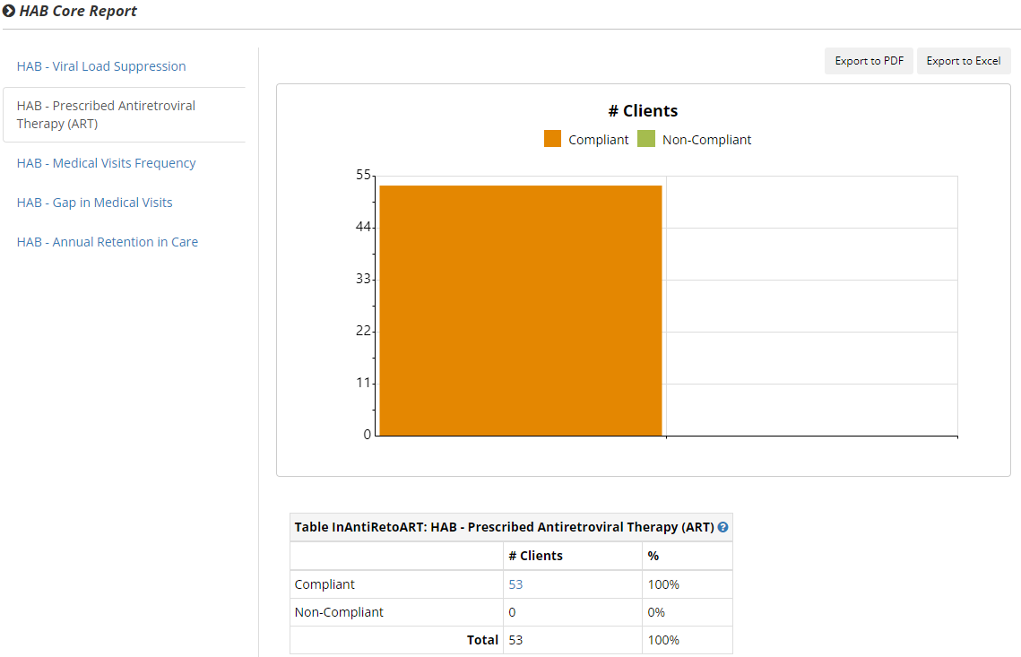
Compliant number in this example will be (53) make a note of this value to be inputted in Column A for new clients for ART Prescribed

Slide 12
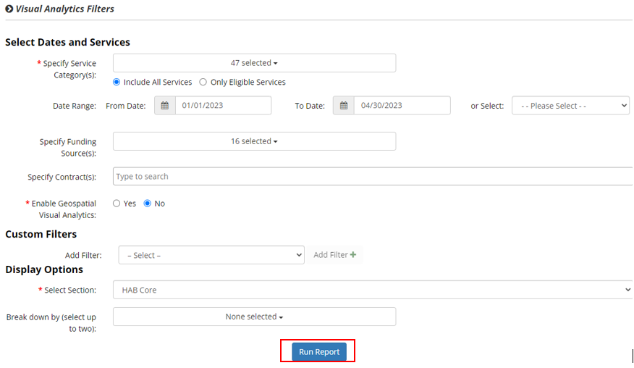
Step 6: Scroll up to previous Visual Analytics, click on Remove Filter, Run Report

Slide 13
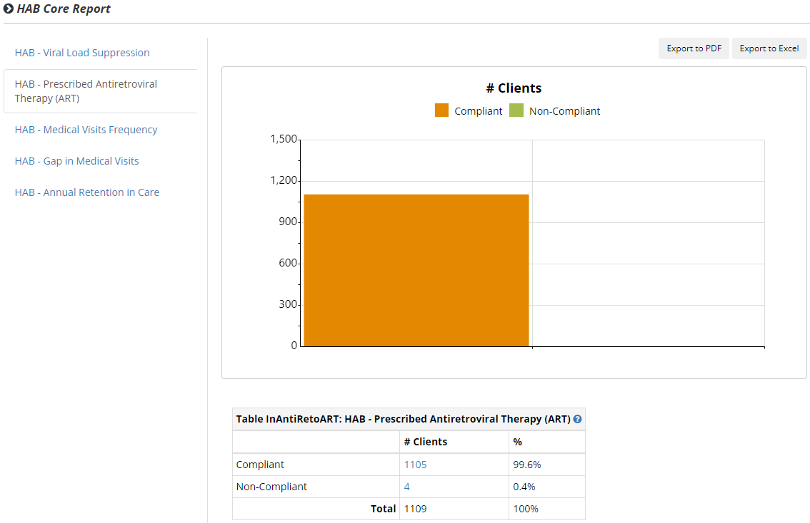
Step 7: Scroll down for your results
In this example, you will subtract, 1105 – 53 from previous results and you will input the amount (1052) in Column B for returning clients. Total clients would be 1105 to input into Column C.

Slide 14
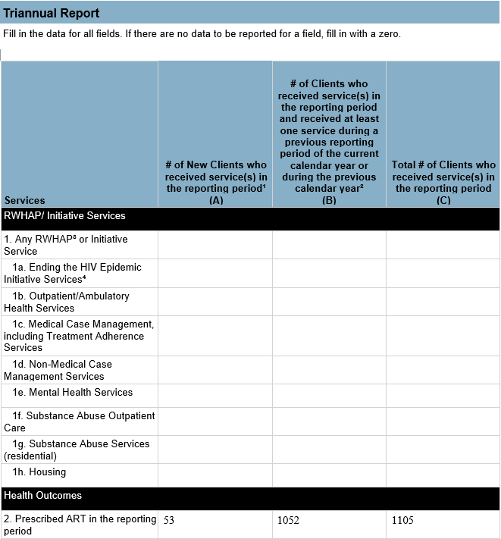
Step 8: Input your Prescribed ART at the bottom of your Triannual Report

Slide 15
*Things to keep in mind*
No boxes should be left blank. If you are not funded for the category or did not provide services during reporting period fill in with zero.
Column B of the triannual report asks for the # of clients that received a service during the current period and a previous period, or a returning client. To get that number you must subtract the number of new clients from total clients.

Slide 16
The final step is uploading your triannual data into the HRSA Electronic Handbook (EHB)
Instructions to submit in EHB can be found here starting on pg. 16 https://targethiv.org/sites/default/files/media/documents/2021-12/EHE_Triannual_Report_Instruction_Manual_2021.pdf

